Slide 1



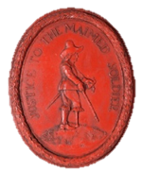
County Court Challenge
Survivors!

Slide 2
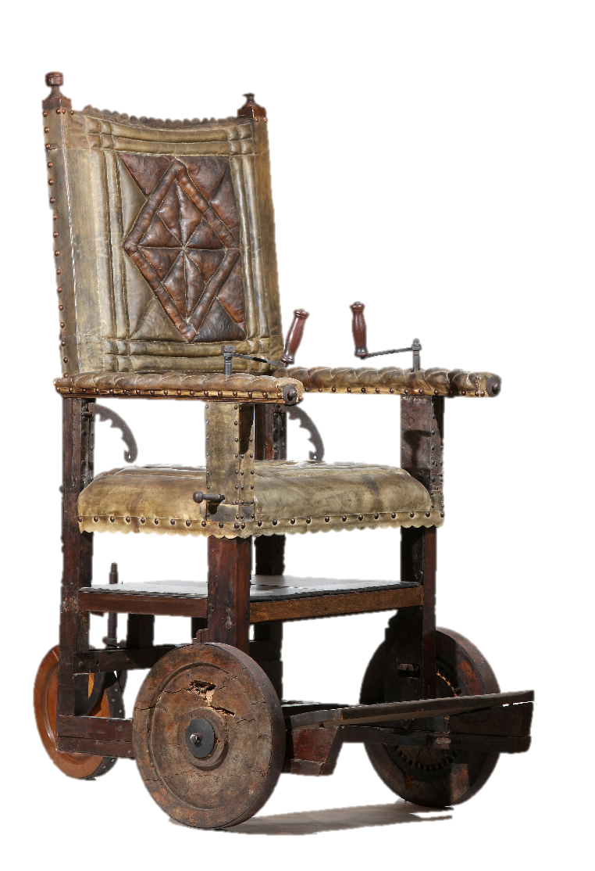

Sir Thomas Fairfax used a wheelchair to help him after the war.
Most people could not afford such a special object

Slide 3
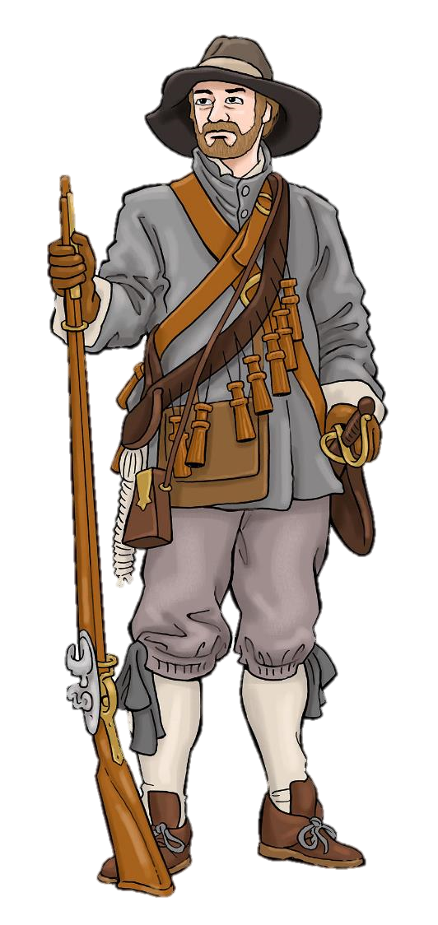

So how do you think ordinary wounded soldiers coped with their injuries?
What might they have used to help them?

Slide 4
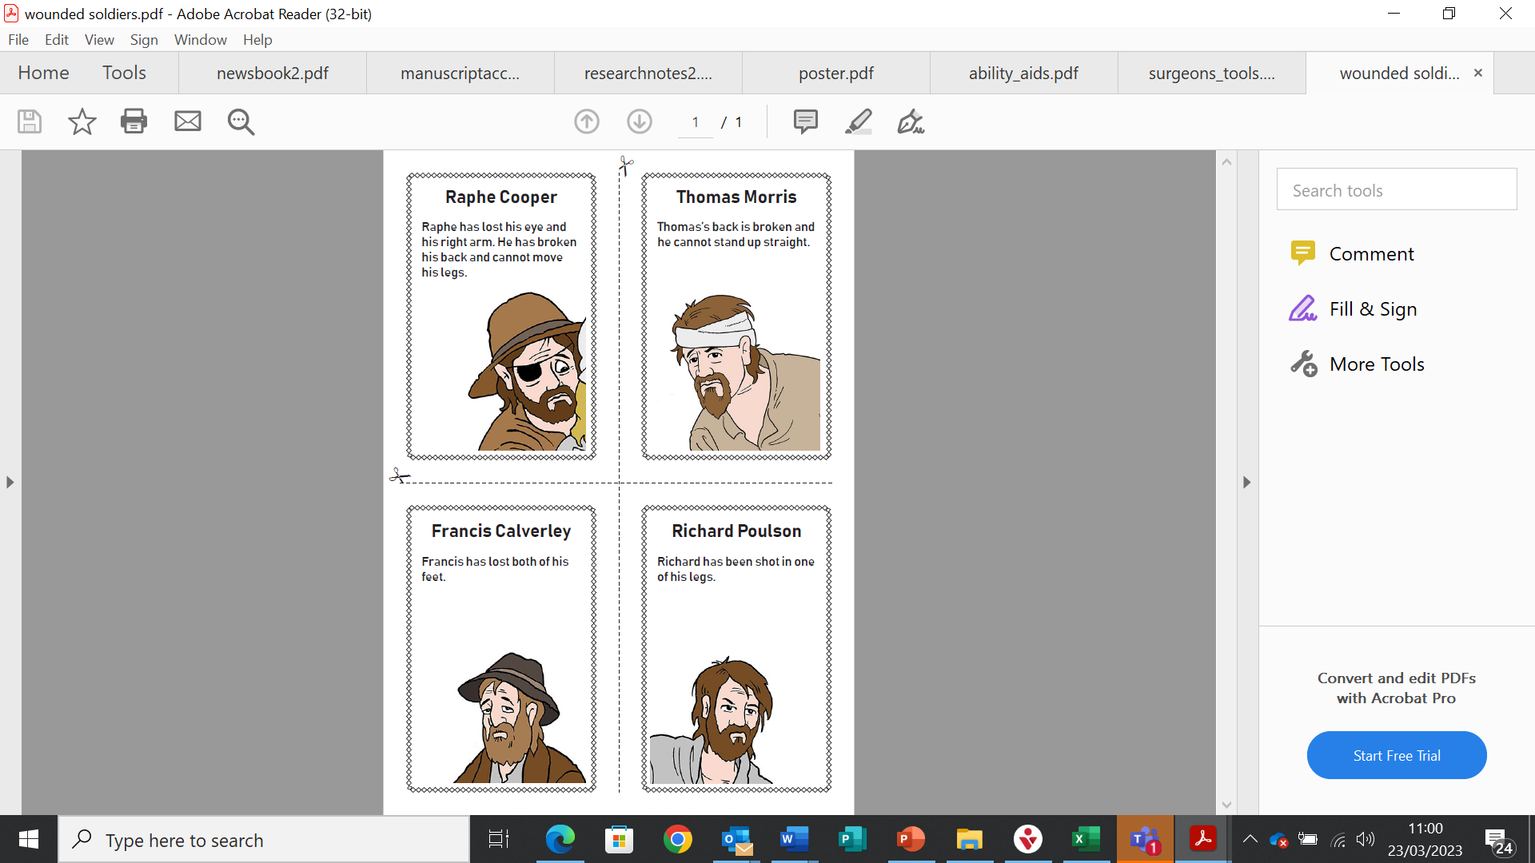
Can you help these men?
Each of these men was wounded in the British Civil Wars.
Each man was treated by a surgeon (doctor) when they were wounded.
Each found a way to cope with the long-term effects of their wounds.

Slide 5
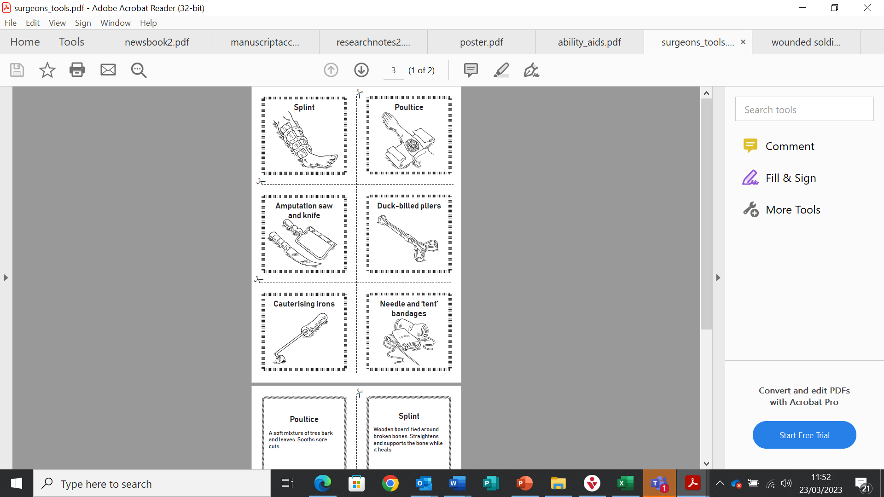
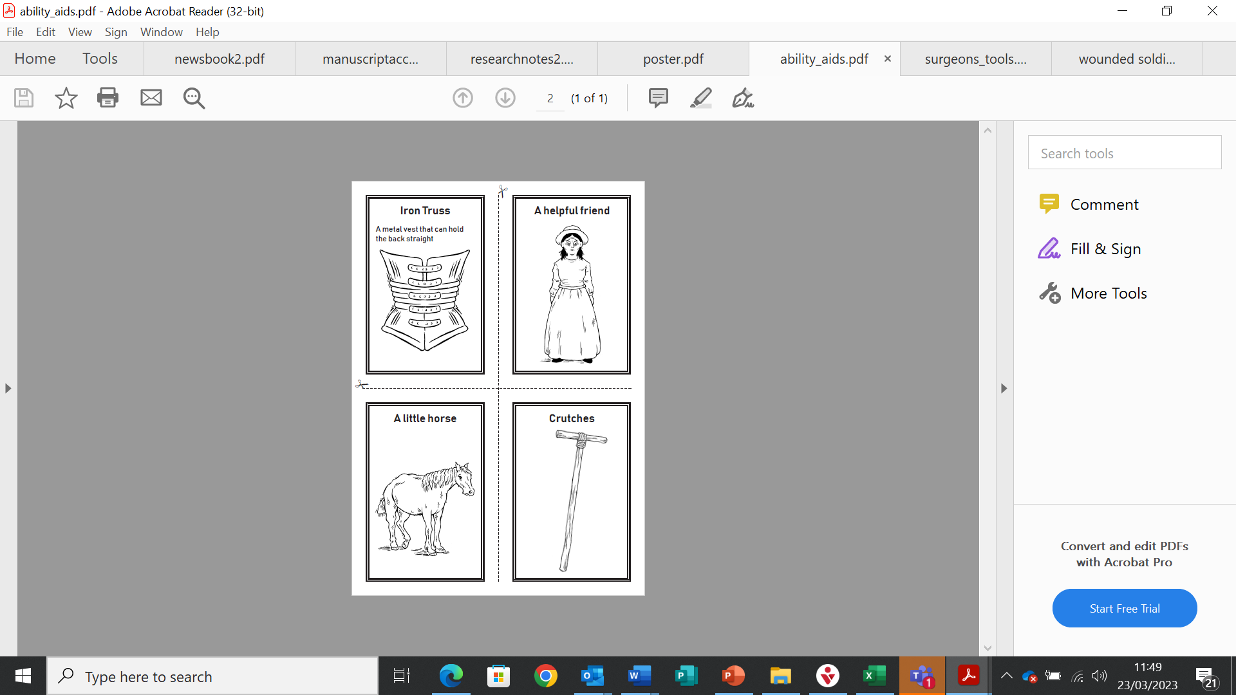

Match each wounded man..
..with a surgeon’s tool (that could save his life)
..and an ability aid
(that will make his life easier)
+
+
When you are ready, the next slides will suggest some answers!

Slide 6
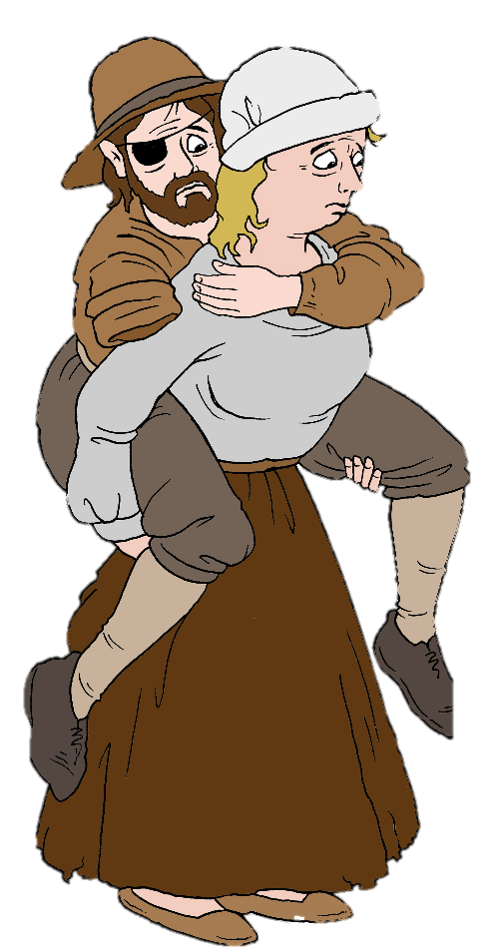
Raphe Cooper had many wounds. His sister had to carry him everywhere because he was unable to move his legs at all.

Slide 7
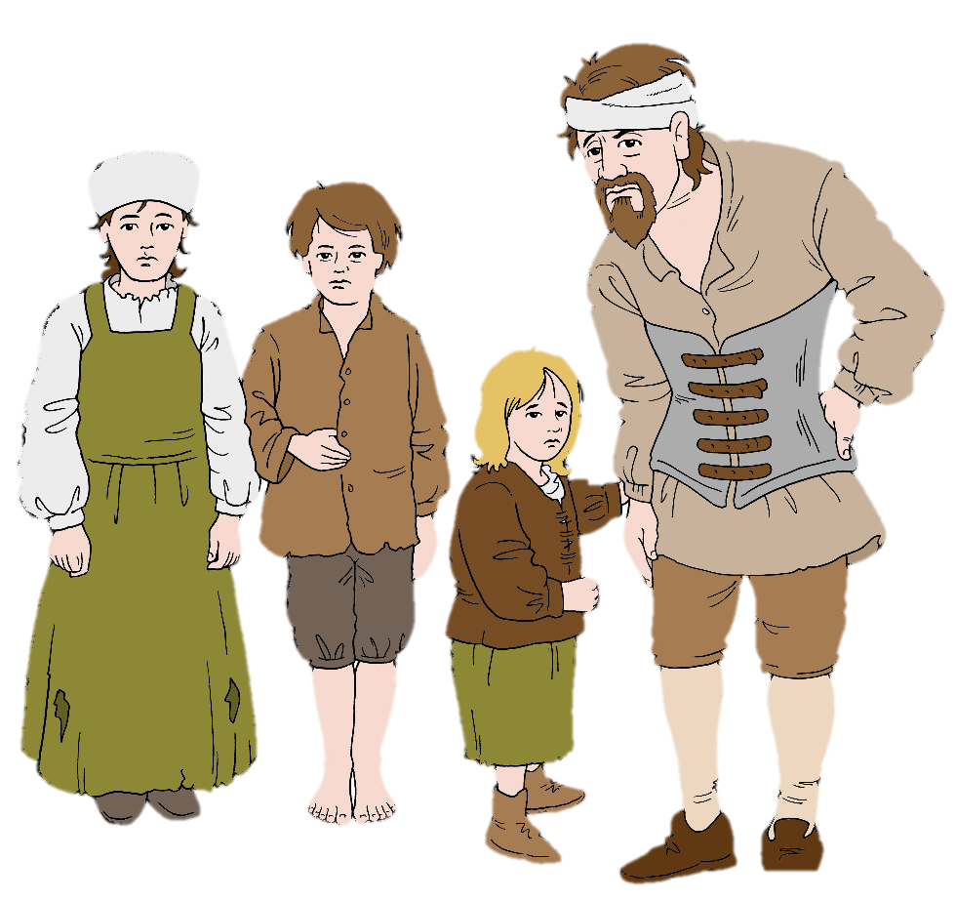
Thomas Morris had a broken back. He could only stand with the help of an iron truss that held his back straight.
His wife had died and he had small children to look after.

Slide 8
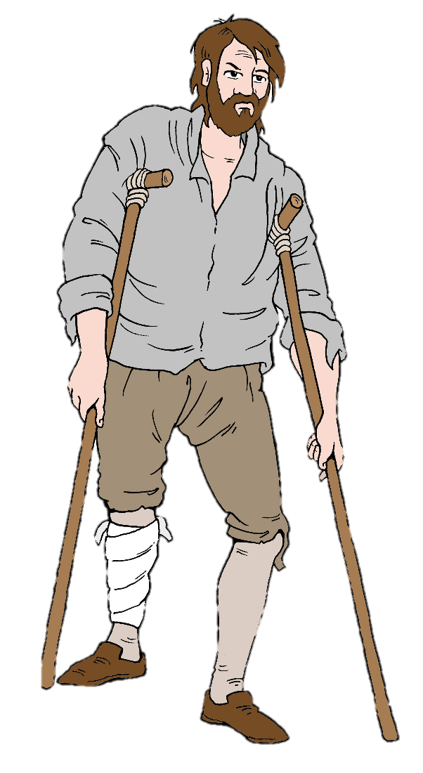
Richard Poulson had a bullet wound in his leg. He used crutches to help him walk

Slide 9
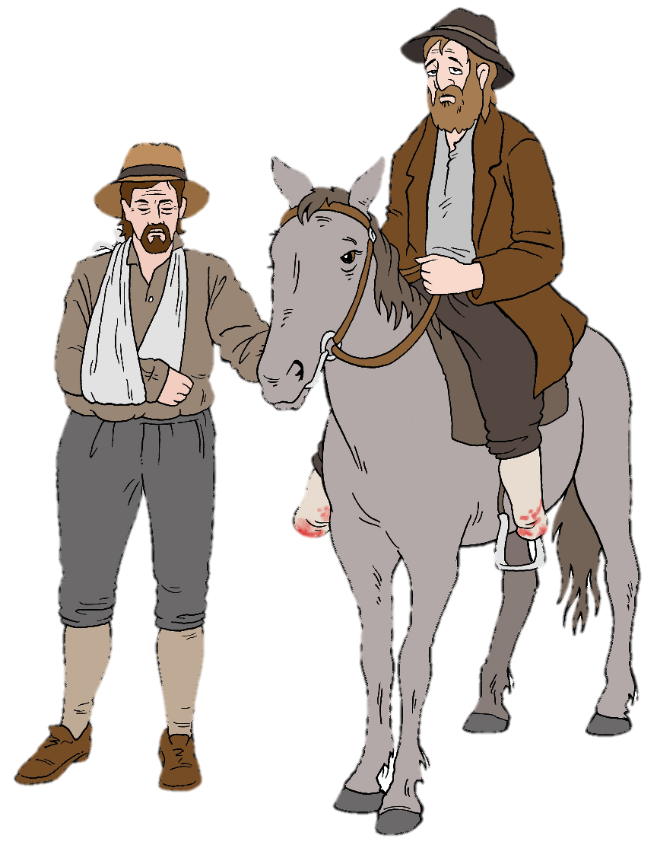
Francis Calverley lost both of his feet in the war.
He had a little horse that helped him to travel.

Slide 10
How do we know about these ordinary people?
After the war, there were thousands of wounded soldiers who could no longer work and support their families.
The families of soldiers who had died were left penniless.
These survivors were able to write a special letter asking for money to help. This was called a petition.

Slide 11
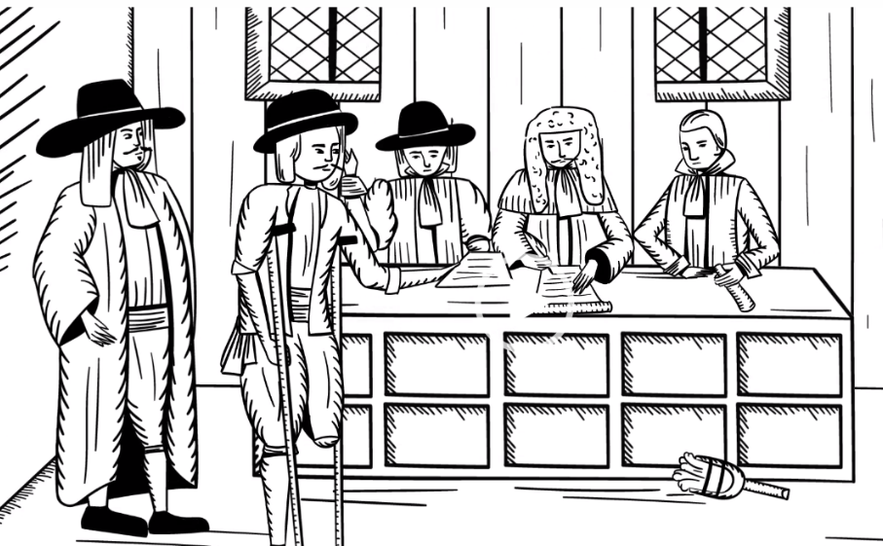
Click the image below to watch a film about these special letters

Slide 12
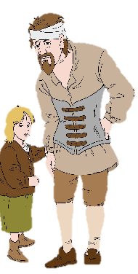
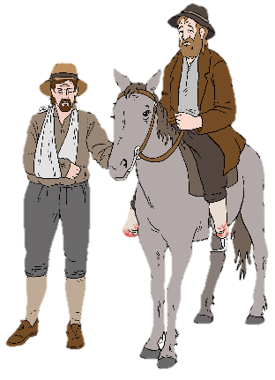

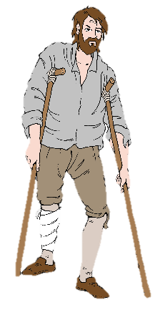

Hold your own County Court
Choose (or invent) a character.
Help your character to write a petition
Present it at the court in your classroom
Decide which character will win a pension.
Use the real-life characters
you have investigated…
Thomas Morris
Francis Calverley
Richard Poulson
Raphe Cooper

Slide 13
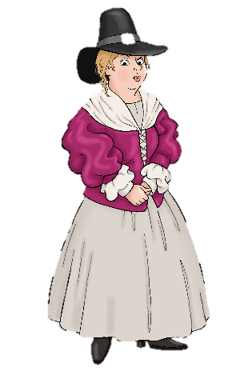
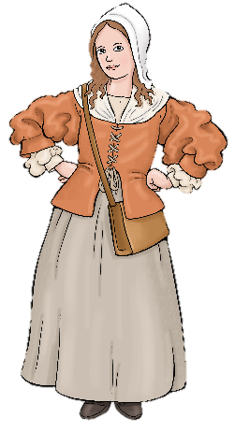
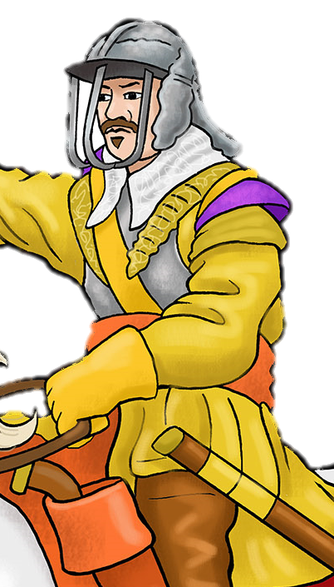
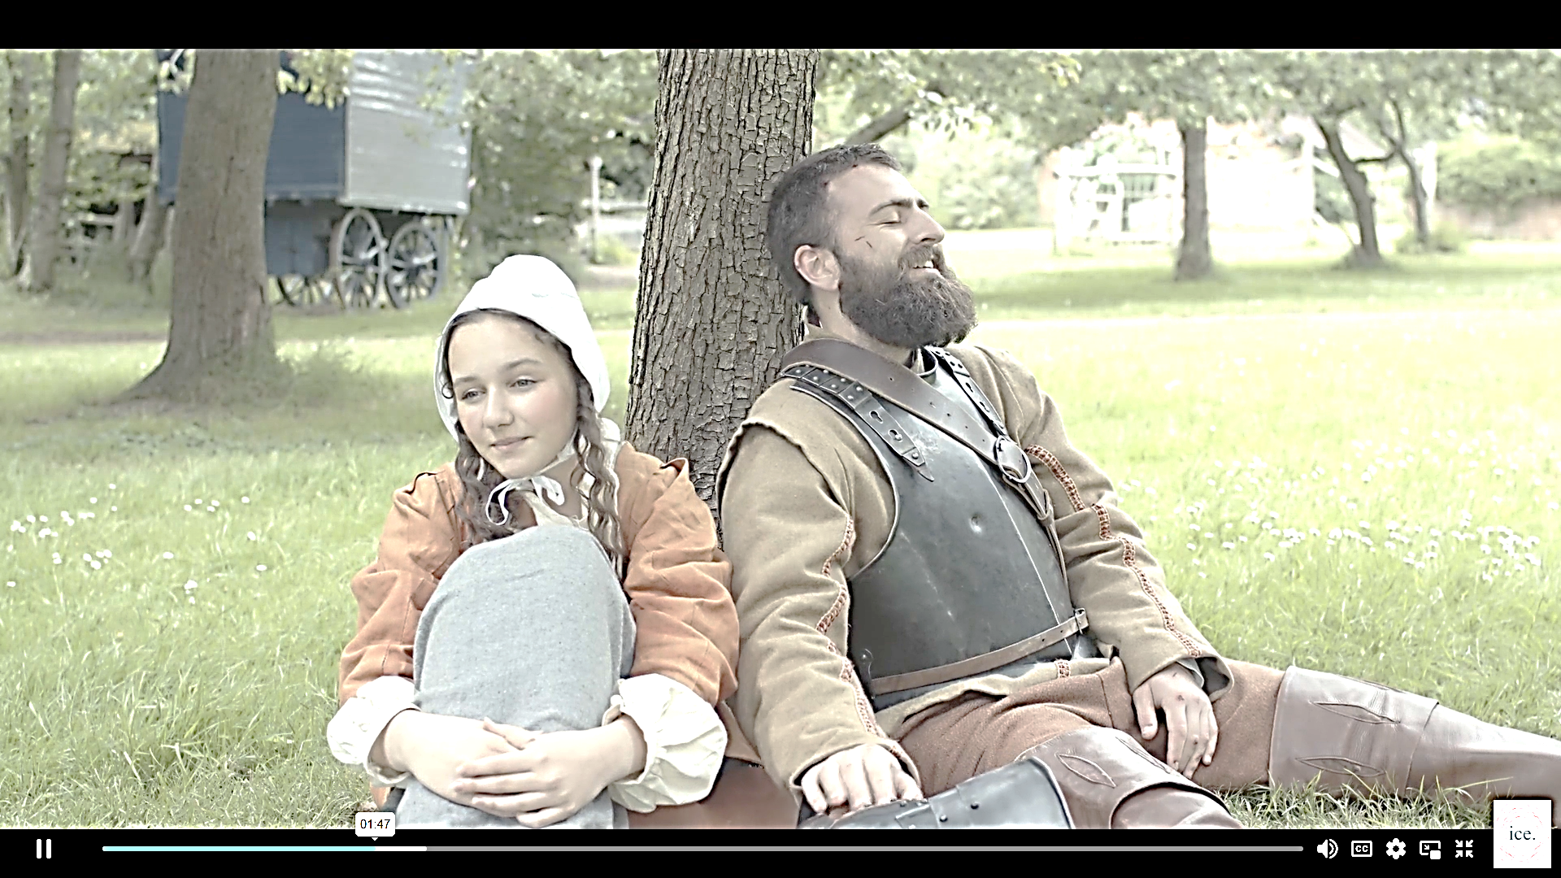
..or use the imaginary characters from our Sieges unit film
..or you could invent your own
Alice Cooke
Mary Clay
Click here to watch the film from the Sieges Unit
Thomas Moss

Slide 14
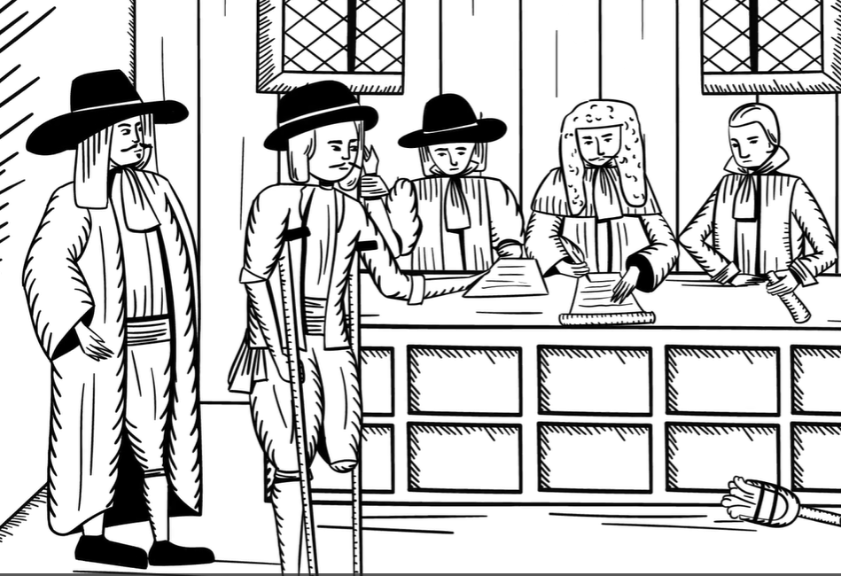
The Classroom Court
Call each petitioner
Ask them to persuade the judges that they deserve a pension
Choose who wins money

Slide 15
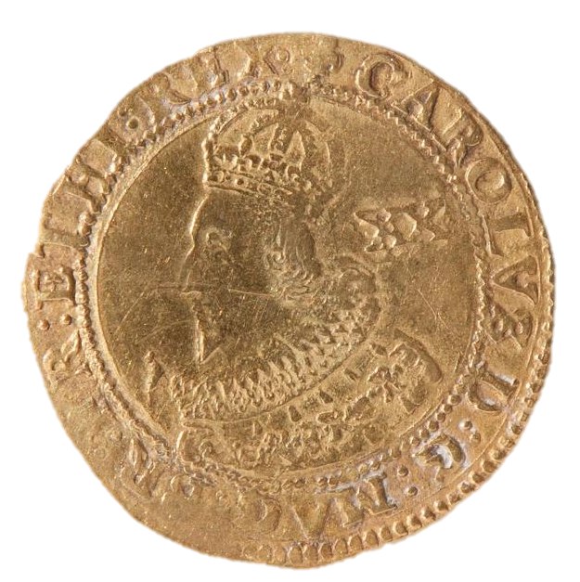
The court has £30 to give away
This £1 coin is called a
Gold Unite.

Slide 16
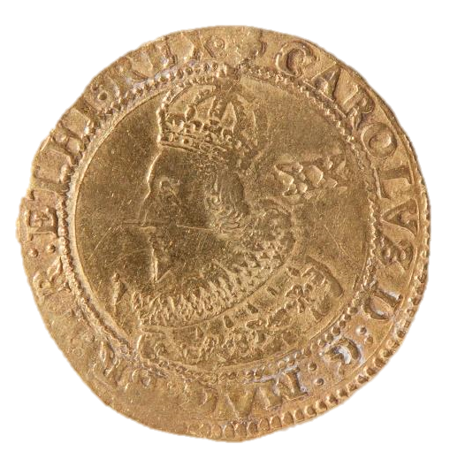
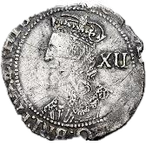
£1
20 s
=

Slide 17
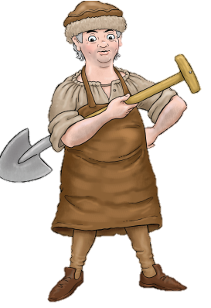
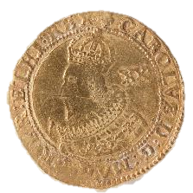
An ordinary person needs £10 a year to survive

Slide 18
The highest prize is an annual pension.
A standard pension is 20-40 shillings a year
The court can also give a one-off lump sum

Slide 19

You must reject at least one petition.
You only have £10 for lump sums
You can only award 1 pension

Slide 20




Click on each character and see their real petition
Richard Poulson
Francis Calverley
Thomas Morris
Raphe Cooper

Slide 21



Find out the real outcome of their petitions
Outcome unknown
Awarded a
one-off payment of 5 shillings
Outcome unknown
Petition rejected
Richard Poulson
Francis Calverley
Thomas Morris
Raphe Cooper

